Slide 1
Department : Diploma in Computer engineering
Course code : Z18602
Course title : Building Internet of Things
Topic : Research of MQTT, CoAP, HTTP and XMPP IoT Communication protocols for Embedded Systems
By - V Abishek -19DX01
N. Nikolov, "Research of MQTT, CoAP, HTTP and XMPP IoT Communication protocols for Embedded Systems," 2020 XXIX International Scientific Conference Electronics (ET), 2020, pp. 1-4, doi: 10.1109/ET50336.2020.9238208.

Slide 2
MQTT: Message Queuing Telemetry Transport
The MQTT architecture has a Client/Server model where each sensor is a client and connects to a server
The server is known as a broker using TCP communication
The MQTT protocol is message-oriented and each message is published on a topic. Customers can subscribe to several topics. Each customer subscribed to a topic receives every message posted in the topic
For security, MQTT brokers may require username and password authentication from customers to connect
To ensure privacy, the TCP connection can be encrypted with SSL/TLS certificate.
MQTT has support for persistent messages stored on the broker. Only the last persistent and constant message is displayed.

Slide 3
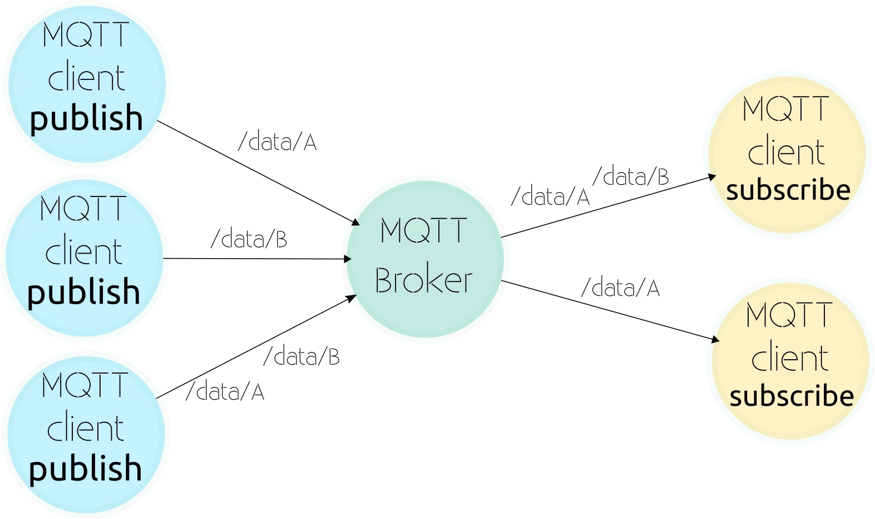

Slide 4
SOFTWARE REALIZATION OF EXPERIMENTAL STAGE :
The Experimental stage uses ESP32 system on chip
To initialize the protocol we must to set the used port, server address and CallBack function:
client.setServer(mqtt_server, 1883);
client.setCallback(callback);
To send a message and subscribe for a Topic are uses the following :
client.subscribe("SetPin4/GPIO");
client.publish("esp32/stateGPIO", Pin4);

Slide 5
CoAP protocol : Constrained Application Protocol
CoAP is designed for the needs of limited devices
CoAP follows the client/server model
CoAP works with UDP Protocol and it is Asynchronous Message Exchange
Clients make requests to servers, servers send back responses. Customers can perform the following GET, PUT, POST, and DELETE operations
CoAP is designed to work in conjunction with the HTTP and REST network through simple servers
CoAP packages are much smaller than HTTP TCP streams. CoAP allows UDP broadcasting and multicast to be used for addressing

Slide 6
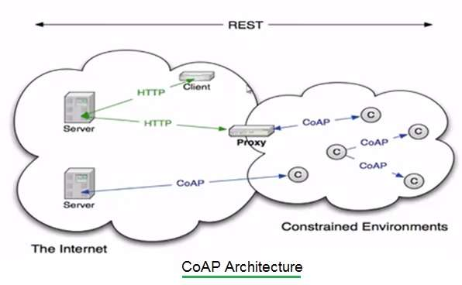

Slide 7
SOFTWARE REALIZATION OF EXPERIMENTAL STAGE :
To set the client response callback, start the client and get request to server are used the follow line of code:
coap.response(callback_response_from_Server); coap.start();
int messageID = coap.get(ip,port,"Lab_example");
To observe request with the server are used :
int msgid= coap.observe(ip,port," Lab_example ",0); (4)

Slide 8
HTTP protocol :hypertext transfer protocol.
HTTP and web sockets are common existing standards that can be used to provide XML or JavaScript Object Notation (JSON) in payload
JSON provides an abstraction layer for web developers to create a comprehensive web application with a permanent web server connection
HTTP is designed for communication between 2 systems only at a time
In most of the IoT applications there are a large number of sensors which are generating data at the same time and want to push this ahead to the server at the same time HTTP does not fulfill the need for one to many communication between sensors and the server
HTTP is a device client, not a server. In other words, it is safer to build an IoT device that can initiate connections, not receive

Slide 9
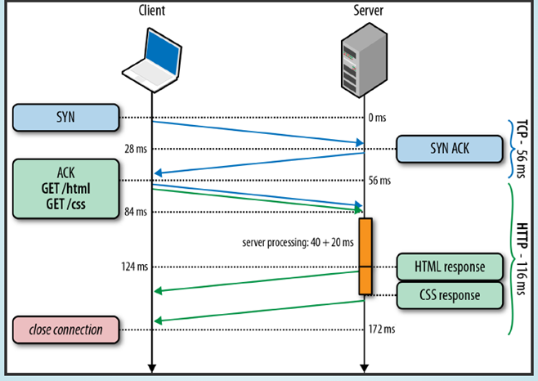

Slide 10
XMPP : Extensible Messaging and Presence Protocol
Messages that is center-oriented and based on XML (Extensible Markup Language)
TCP communication protocol based on XML.
This is an open real-time communication technology that allows a wide range of applications including instant messaging, presence, lots of private chat, voice and video calls, collaboration, light middleware, content and generalized routing of XML data
XMPP allows two clients to exchange text messages in near-real-time

Slide 11
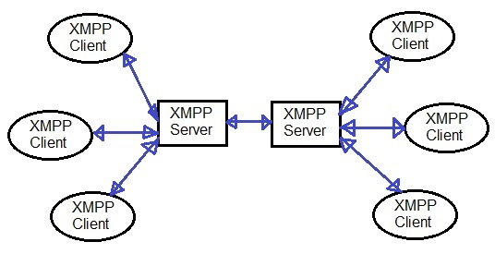

Slide 12
SOFTWARE REALIZATION OF EXPERIMENTAL STAGE :
To connect to the server in the client :
Ethernet.begin(mac, ip);
if (client.connect("esp32", "test.Lab", "example", "avrud0")) {
client.sendPresence();
}
//where the ip and mac address are set and connection parameters.
To send the messages to XMPP server are used:
client.sendMessage("admin@ test.Lab ", "hello");

Slide 13
Protocol | Advantages | Disadvantages
MQTT | - Ideal for low energy consumption. - Requires lightweight resources to build an applied stack. - The message header can be as small as 2 bytes. This makes it very effective on connection width, as ideal for limited networks. - Supports all messages on the network (publish / subscribe and request / reply). | - No queue of messages is maintained, with only the most recent messages stored in the broker - Header fields such as TTL (Time to live) sent to the user are not supported - There is no message property section
CoAP | - It has the same concept as the REST model, but aside from TCP -Very fast device-to device communication via UDP | -There are the same weaknesses as REST, but aside from the quality of the service level -Offers a variable level of service - Supports only message model
XMPP | -Uses XML text format as native type -Performs person-to person communication uses TCP | -No significant disadvantages
HTTP | -Does not require a client library to be supported by the IoT device -Simplifies architecture if data loss allowed -provides ' lowest common denominator 'connectivity after most devices use GET or POST | -Header fields are relatively long -No support for the quality of service -The application must handle all reliability

Slide 14
Protocol | Messages type | Constrained network GPRS, 2G, 3G | Low Power | Architecture | Security | Transport
MQTT | Publisher/ Subscriber | Excellent | Good | Tree | medium may use SSL | TCP / IP
CoAP | Request/ Response | Excellent | Excellent | Tree | medium DTLS | UDP / IP
XMPP | Publisher/ Subscriber | Excellent | Poor | Client Server | High TLS/ SSL | TCP / IP
HTTP | Request/ Response | Excellent | Poor | Client Server | Low | TCP / IP
HTTPS | Request/ Response | Excellent | Poor | Client Server | High TLS/ SSL | TCP / IP

